Slide 1

BA810 Team 2
Predicting Airbnb Listing Prices
Notes:
There presatioation is much better than ours

Slide 2


Agenda
Overview and Objectives
Linear Regression
Ridge & Lasso
Boosting Trees
Bagging & Random Forest
Summary & Conclusion

Slide 3
Overview & Objectives

Slide 4
OBJECTIVE
Predict listing prices of Airbnbs in major U.S. cities based on characteristics

Slide 5
Why is the project worth undertaking?
Implications of the work
Hosts:
Evaluates what their Airbnb prices should be compared to the market
Visitors:
Decipher the value of the deal they are getting
Increase market efficiency
supply & demand
Reduces opportunity costs for participants in competitive markets
Evaluate prices as a third party, and eliminate any stakeholder-bias that may exist in the existing Airbnb “Smart Pricing” tool
Third-Party Pricing Tool:

Slide 6
Approach
EDA
Data Cleaning
Machine Learning Models
Evaluation
Conduct an exploratory analysis of the dataset
Clean the data to treat missing values and unusable features for Machine Learning
Implement a variety of Machine Learning models
Evaluate the performance of each model and compare results

Slide 7
Data Overview
29
Variables
19 Categorical Variables
10 Numeric Variables
TURNED TO DUMMIES
(186 Variables)
'Host_has_profile_pic'
'Host_identity_verified'
'Instant_bookable'
'Number_of_reviews'
'Review_scores_rating'
'Cancellation_policy’
'Cleaning_fee'
Property_type'
'Room_type'
'Amenities’
'Bathrooms'
'Bed_type'
'City'
‘Neighborhood’
72,955
Total clean rows
DROPPED
'Id'
'Name'
'Last_review'
'Host_since'
'Description'
'First_review’
'Thumbnail_url'
'Latitude'
'Longitude'
'Zipcode'
70:30
Training:Testing
NUMERIC VARIABLES KEPT
'Log_price'
'Host_response_rate'
'Review_scores_rating'
‘Accommodates'
'Number_of_reviews'
Data Source - Kaggle (https://www.kaggle.com/rudymizrahi/airbnb-listings-in-major-us-cities-deloitte-ml)

Slide 8
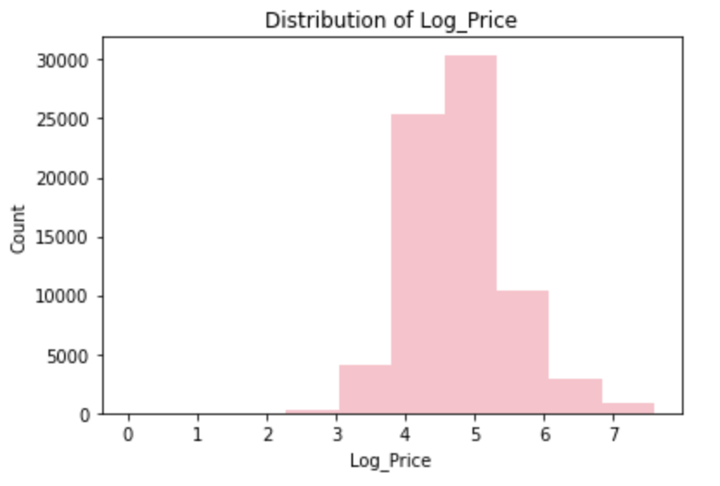
Descriptive metrics about our dataset helped inform our business question
While the averages were helpful in broadly understanding the dataset, they were probably subject to outliers in the data
Using log price vs actual prices helped to scale the target variable across our analyses
Avg Log Price | Avg Bedrooms | Avg Beds | Avg Bathroom | Avg Log Price for SF | Avg Log Price for Chicago
4.78 | 1.27 | 1.71 | 1.23 | 5.17 | 4.62

Slide 9
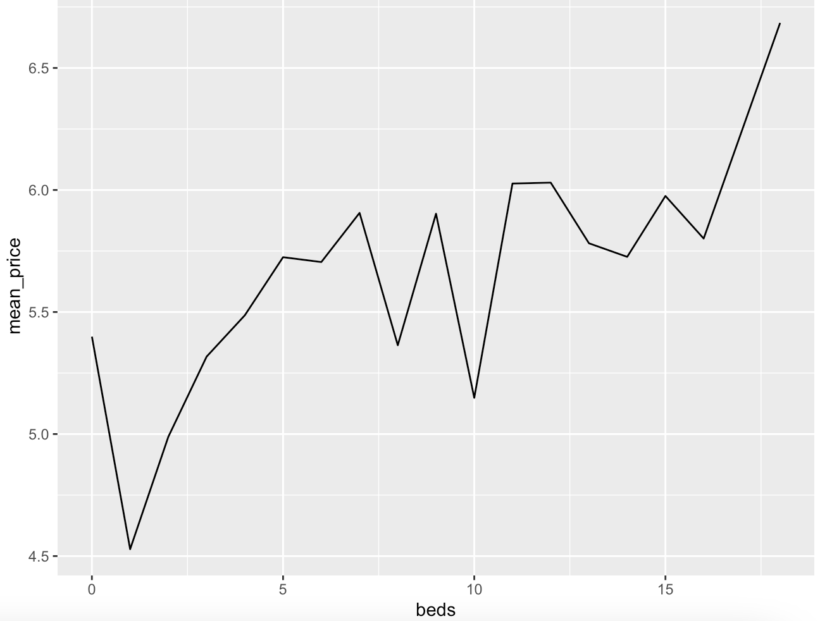
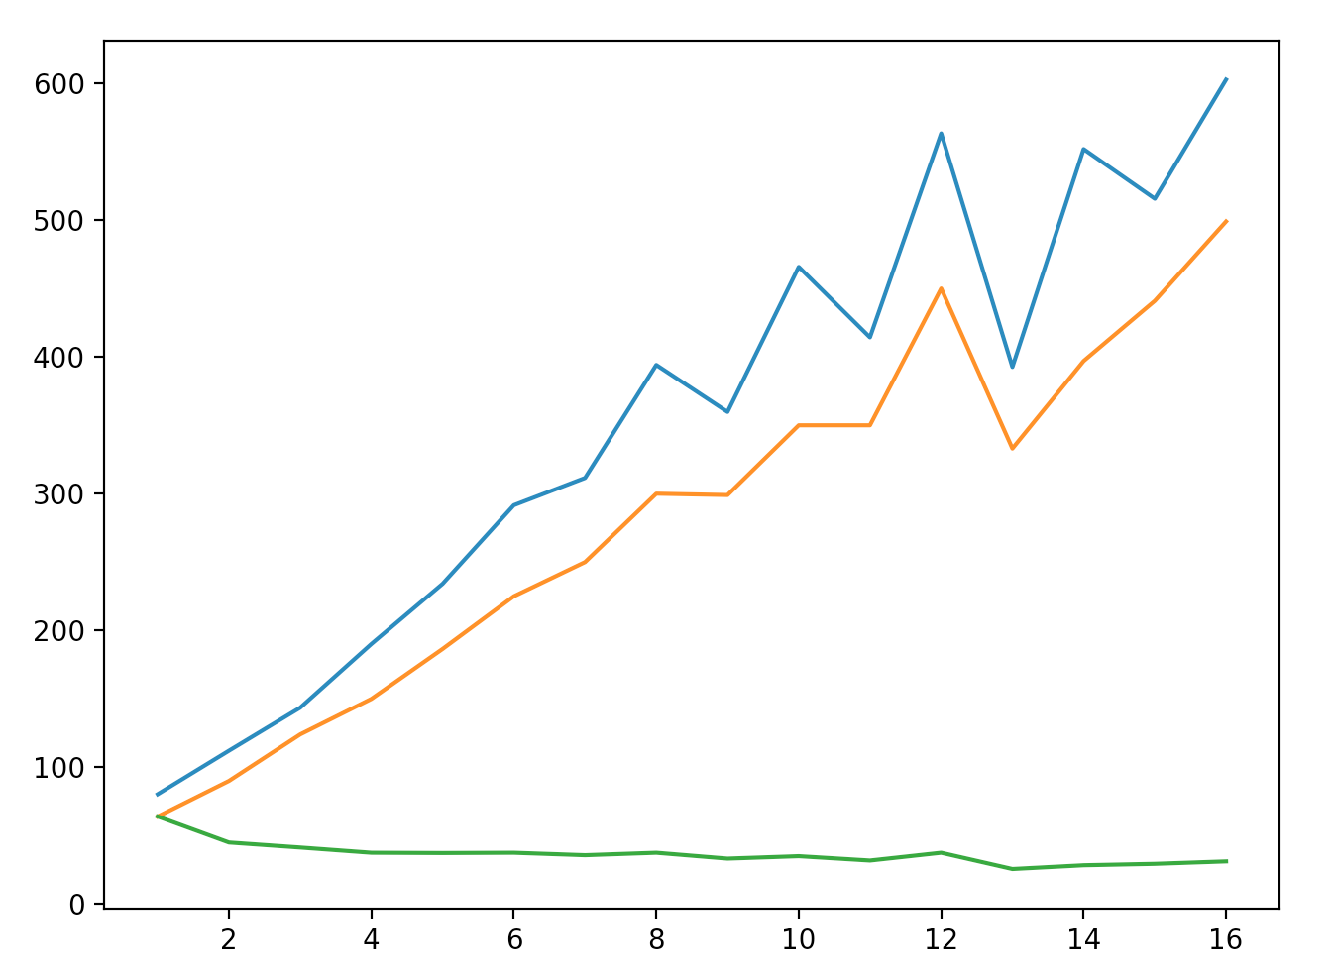
Basic plots of features against price
Investigating the relationship between variables, such as number of beds and capacity of airbnb with price, at a broad level allowed us to better understand the dataset and create relevant hypotheses
Price on Capacity
Price on # of Beds
Median Price
Mean Price
Mean Price ($)
Price ($)
Mean Price
Per-person
# of Beds
Capacity (# of people)

Slide 10
Linear Regression
Forward and Backward Selection

Slide 11
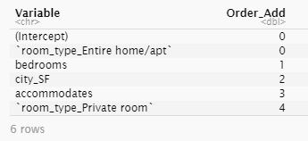
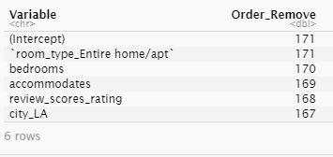
Forward & Backward Selection
Caret package: train()
Using of cross validation
Best model: using all predictors
MSE test = 0.21

Slide 12
Ridge & Lasso

Slide 13
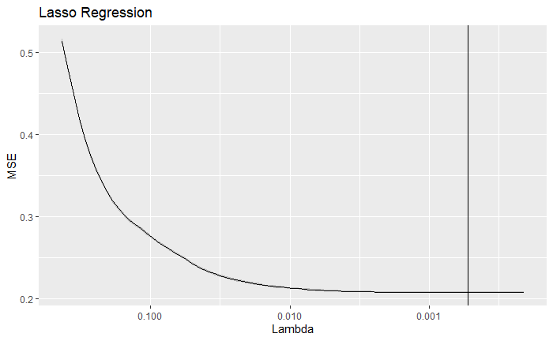
Lasso Regression
mse.test.lasso: 0.2107
min λ: 0.0006
Lowest mse due to variable selection (reduced 64 coefficients)
cv.glmnet selects min λ value for lowest mse

Slide 14
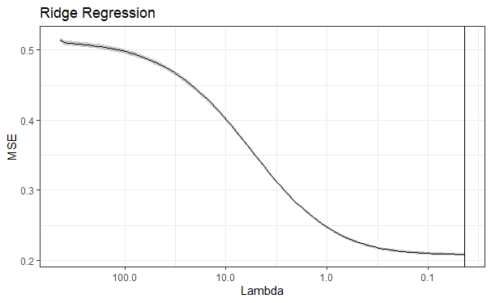
Ridge Regression
Chart Title
mse.test.ridge: 0.2116
min λ: 0.04
Data does not have many powerful predictors
Log Price

Slide 15
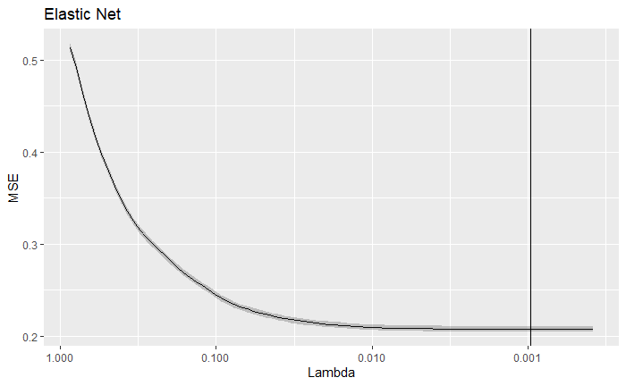
Elastic Net Regression
mse.test.elastic: 0.2111
min λ: 0.0007

Slide 16
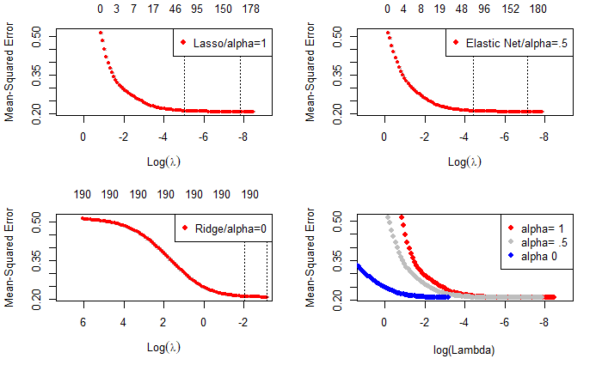
Comparison

Slide 17
Boosting Trees

Slide 18
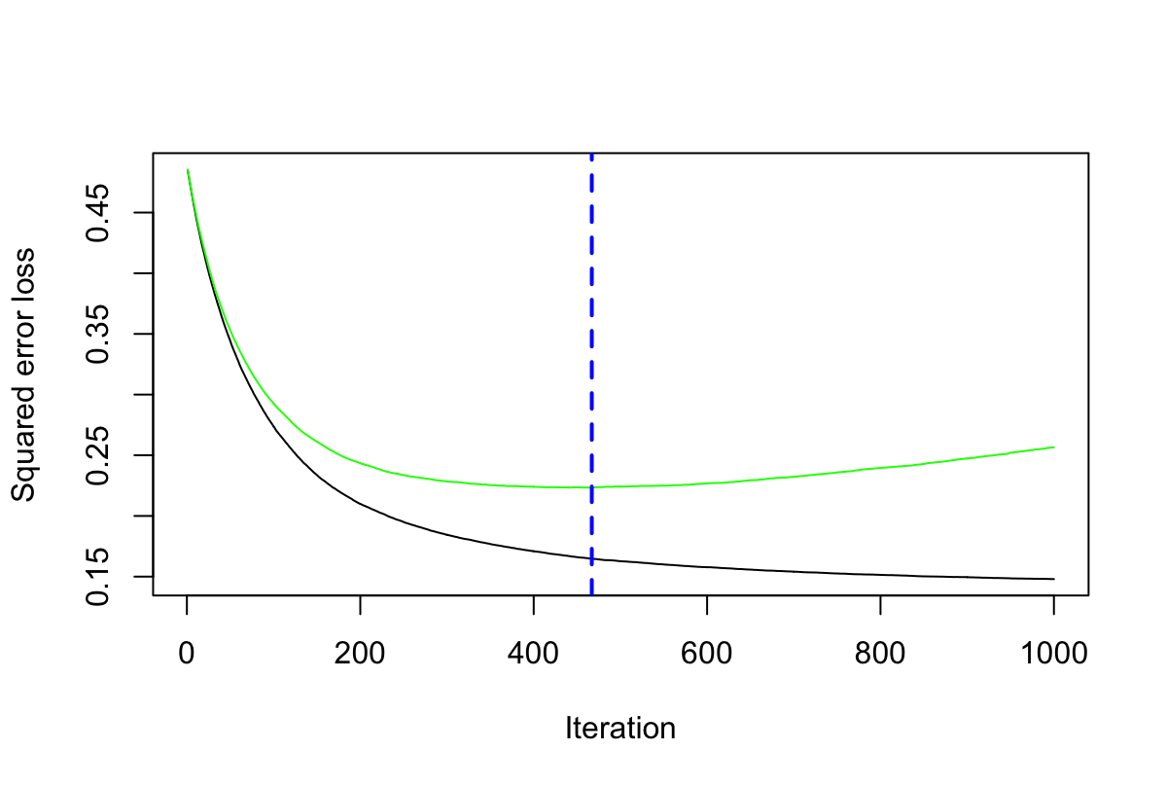
Generalized Boosted Regression Modeling
Chart Title
Variable- Date can’t include
Sample size = 5000
n _ tree = 1000
Shrinkage = 0.01
Running time = 5 mins
method = "cv"
MSE_test = 0.2110
MSE_train = 0.1648
467
zipcode --225435.47435
accommodates --41626.87376
bedrooms -- 39204.68289
bathrooms -- 31777.27042

Slide 19
Comparing Parameters and Results
 | opt_n_tree | Run time | MSE_Train | MSE_Test
n.tree = 1000 Inter.depth = 2 Shrinkage = 0.01 | 469 | About 5 mins | 0.165 | 0.211
n.tree = 1000 Inter.depth = 4 Shrinkage = 0.01 | 291 | About 8 mins | 0.139 | 0.203
n.tree = 1000 Inter.depth = 2 Shrinkage = 0.005 | 984 | About 10 mins | 0.168 | 0.212

Slide 20
Bagging & Random Forest

Slide 21
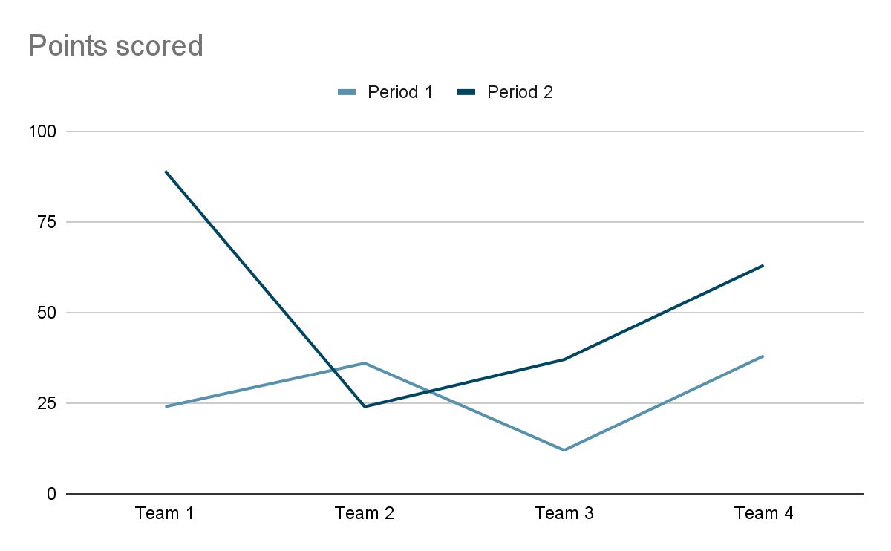
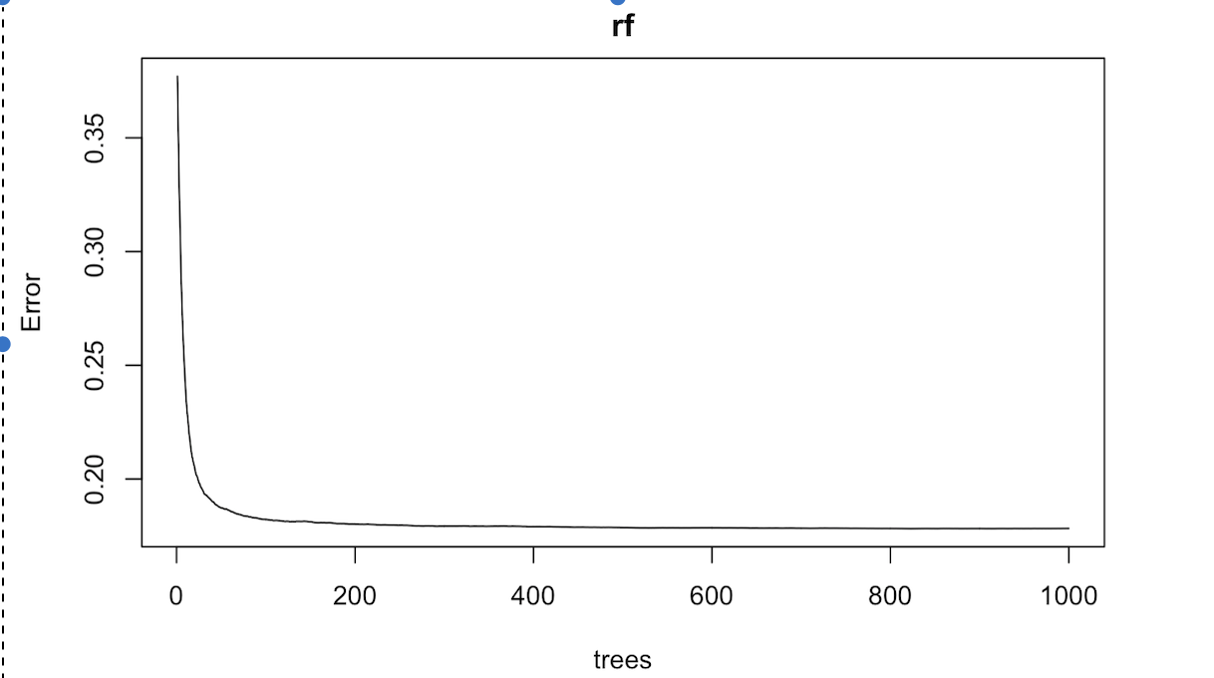
Building the model
OOB
The whole training set is too large to handle: split it again!
Try 14 variables at each splits.
The OOB stop decreasing after building 200 trees.
Mean of squared residuals: 0.1782594
Log Price
# of Bathrooms

Slide 22
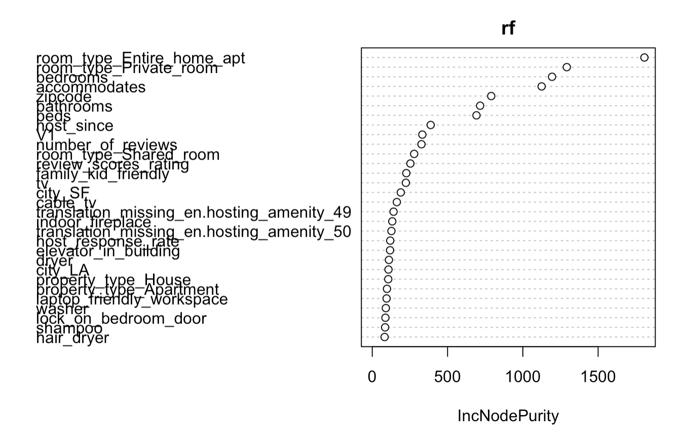
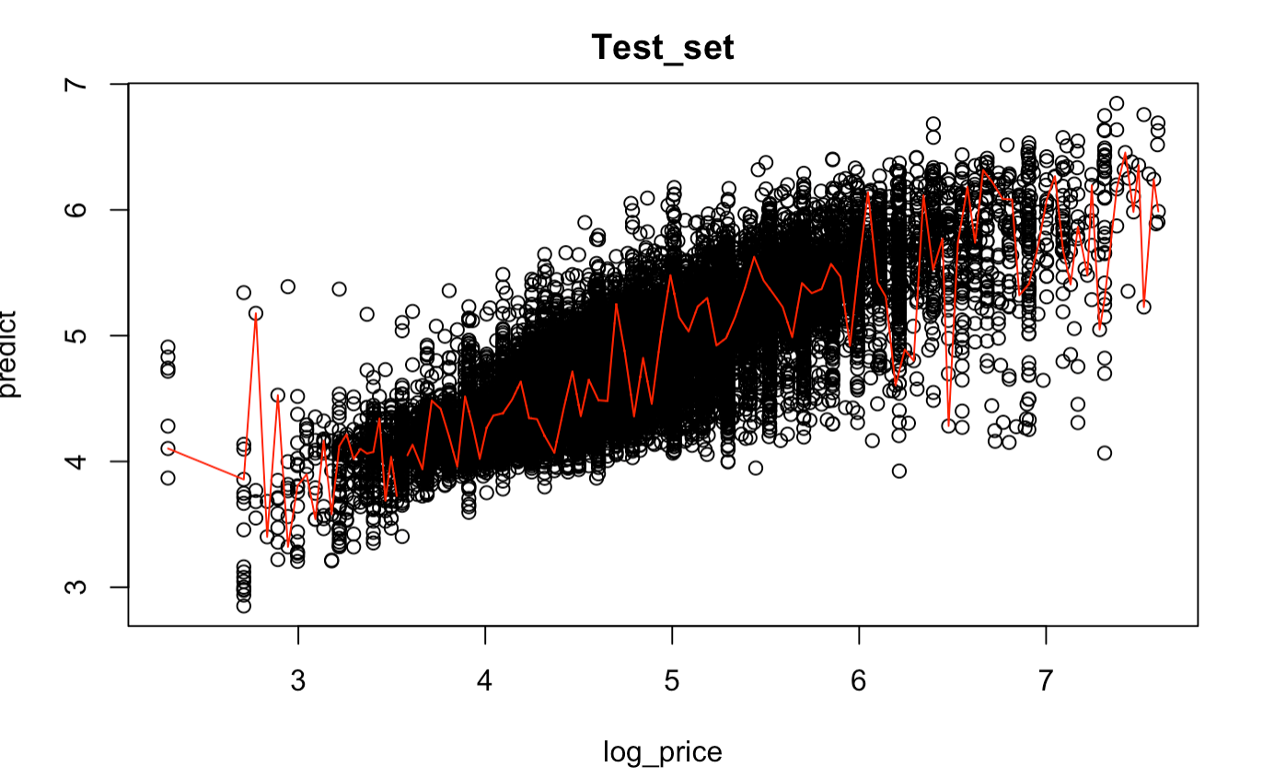
Illustration
The prediction is approximately equal to the real log_price in test dataset.
Room type, accommodation and location have most influence on the price on houses.
Xxxxxxx
x
x
x
xxxxx
Log Price

Slide 23
Summary & Conclusions

Slide 24

Challenges Faced
Cleaning dataset especially parsing out amenities features
Making sure test data is aligned across models
Computationally heavier models were difficult to use given time and resources
Using certain categorical variables in regression

Slide 25
Test MSE 0.178
Random Forest had the lowest Test MSE and is our best model

Slide 26
Conclusions
Computational Limits
While Random Forest had the lowest MSE for this business question and test set, this model required time and resources to train
With more time to train more trees, MSE may have reduced
Cleaning Data
A clean dataset / careful feature engineering is crucial to train models for optimal results
Treating missing values and categorical variables is a key step before model training
Conceptual Understanding of Supervised ML
Models take a lot of time and resources to train and test
It is essential to understand the core concepts to then fine tune the model optimally through the hyperparameters

Slide 27

Thank You
Q&A

